Slide 1
Vertebrate development

Slide 2
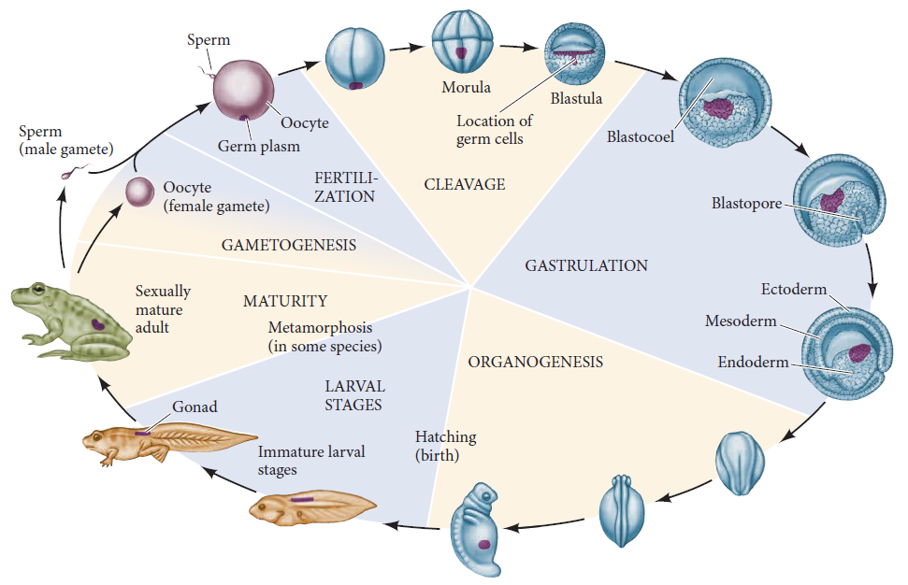
The early stages of development, as exemplified by a frog

Slide 3
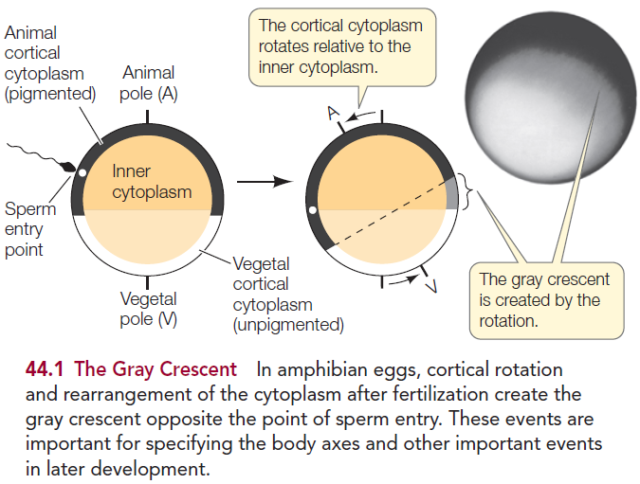
Gray Crescent formation

Slide 4
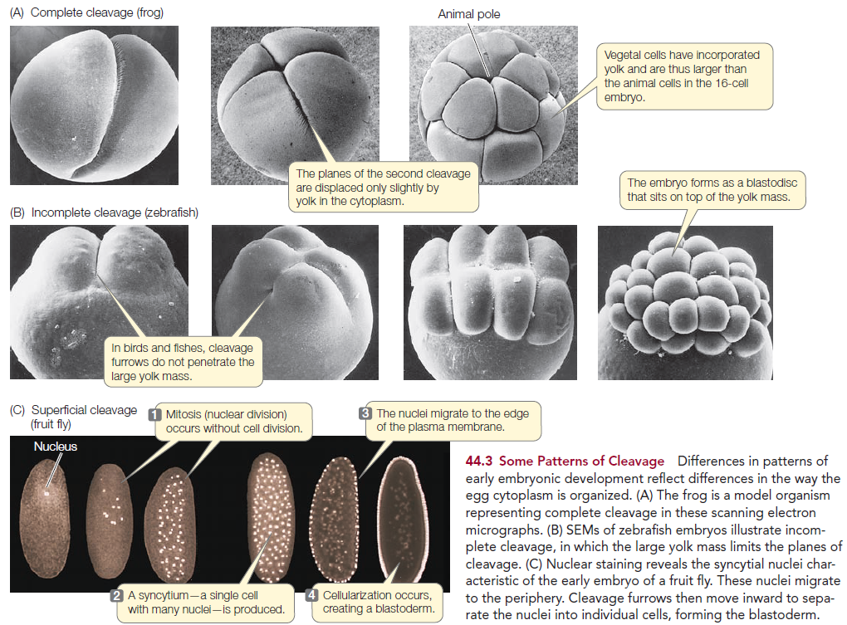
Some patterns of cleavage

Slide 5
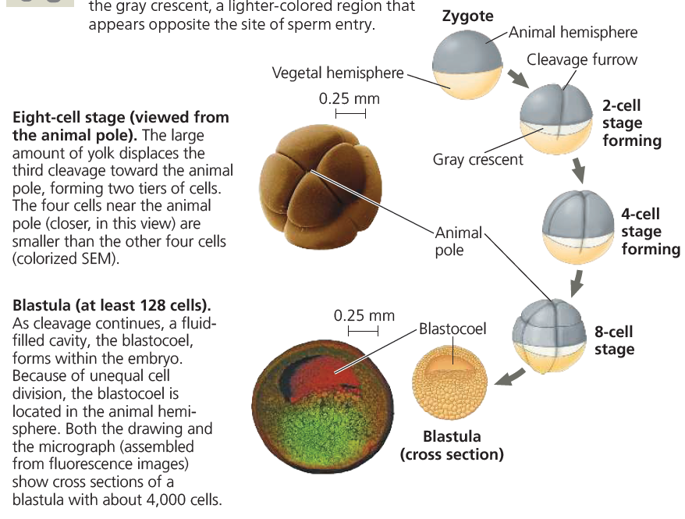
Cleavage in a frog embryo

Slide 6
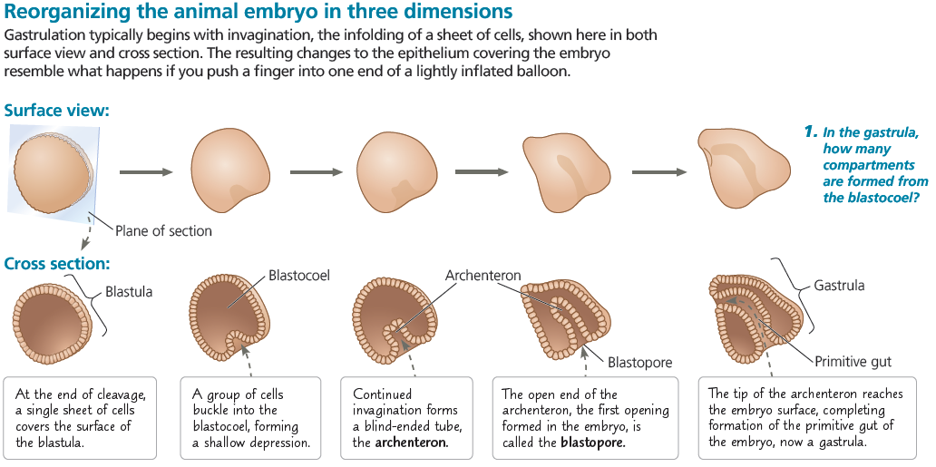
Gastrulation

Slide 7
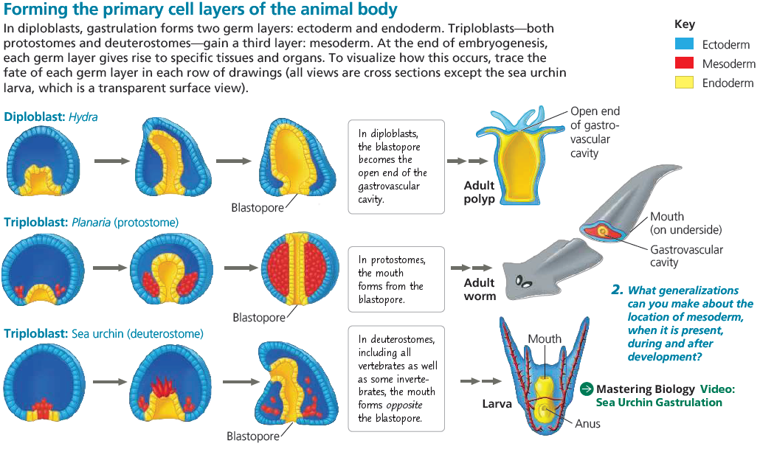
Gastrulation

Slide 8
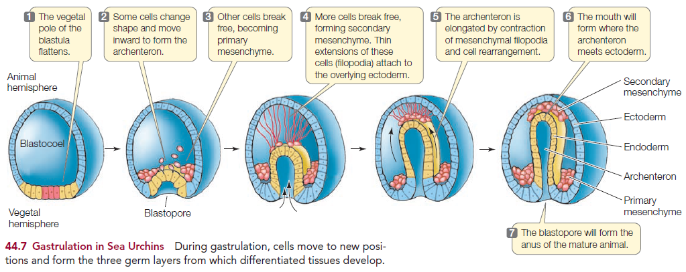
Gastrulation in sea urchin

Slide 9
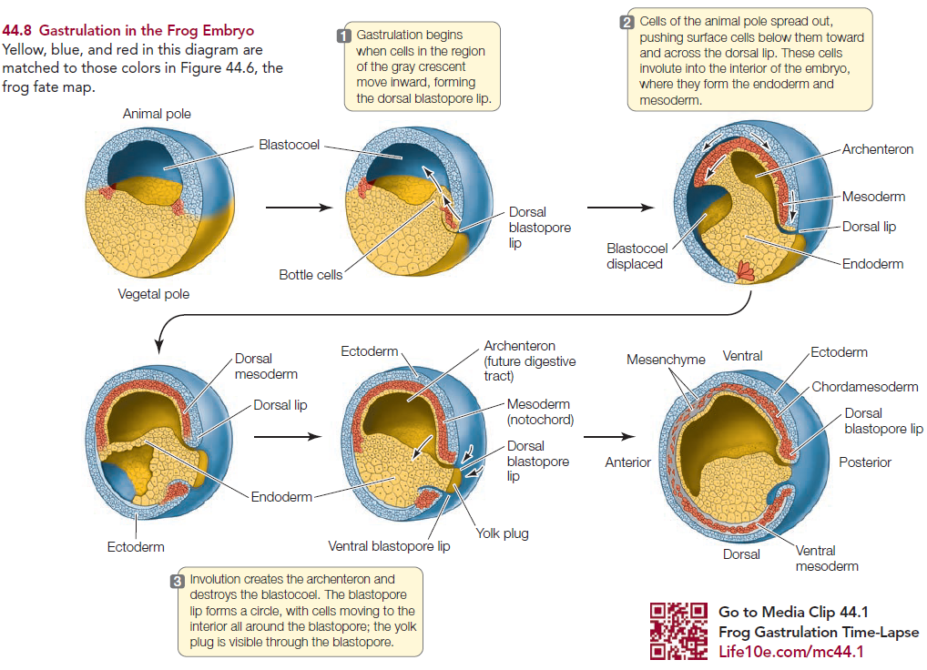
Gastrulation in frog

Slide 10
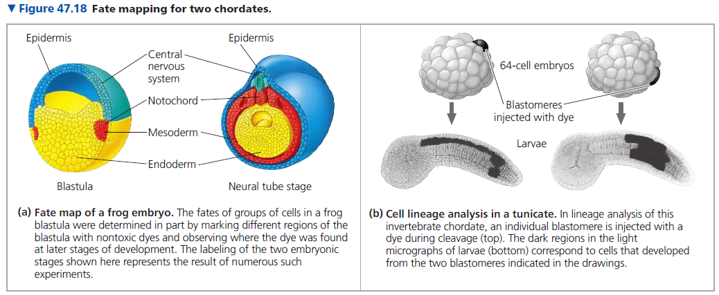
Fate mapping

Slide 11
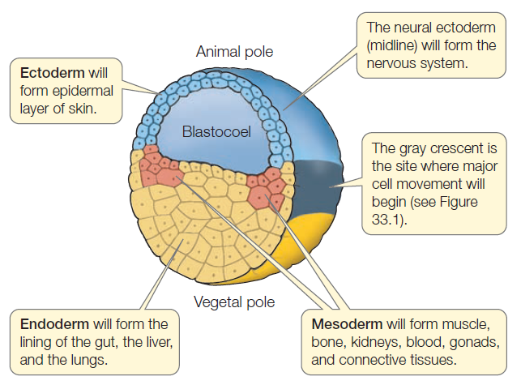
Fate Map of a Frog Blastula

Slide 12
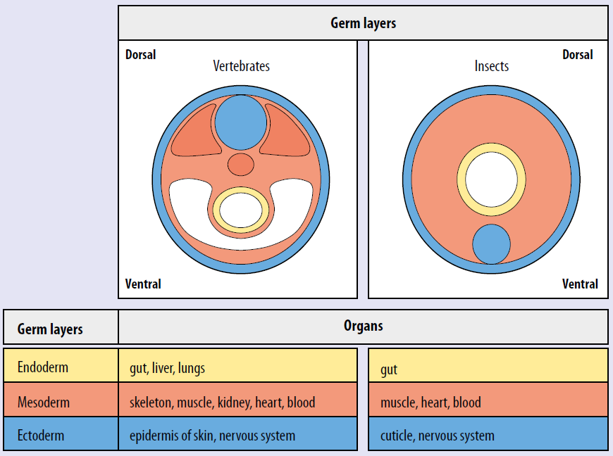
Fate maps of germ layers—ectoderm, mesoderm, and endoderm

Slide 13
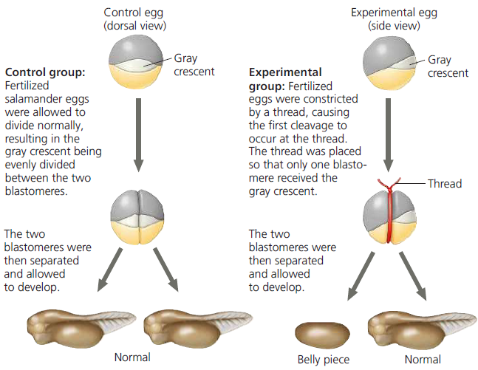
Cell Fate Determination and Pattern Formation by Inductive Signals
Spemann’s research revealed that gastrulation and subsequent normal development in salamanders depend on cytoplasmic determinants localized in the gray crescent.

Slide 14
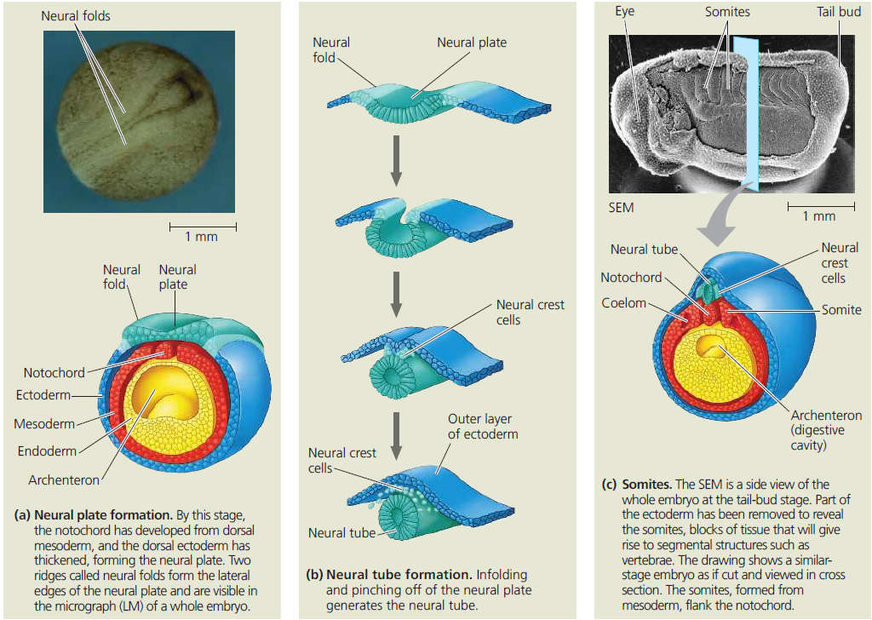
Organogenesis: Neurulation in a frog embryo

Slide 15
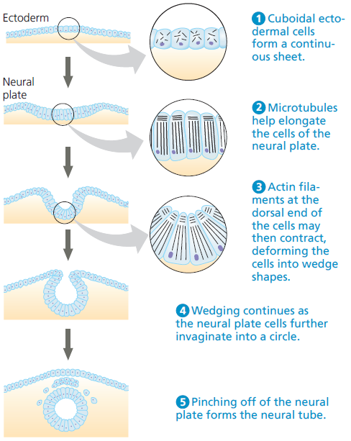
Change in cell shape during morphogenesis

Slide 16
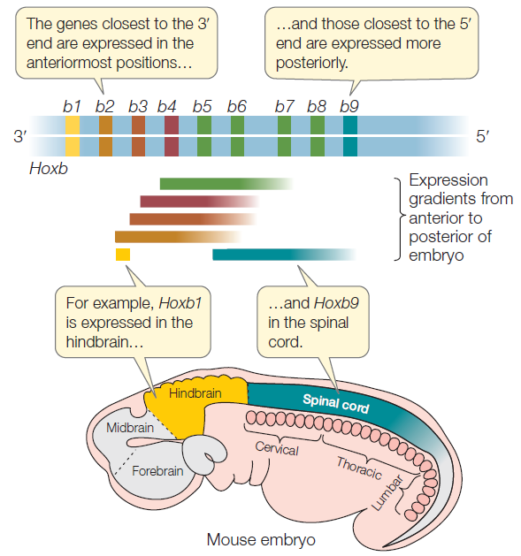
Homeotic (Hox) Genes Control Body Segmentation

Slide 17
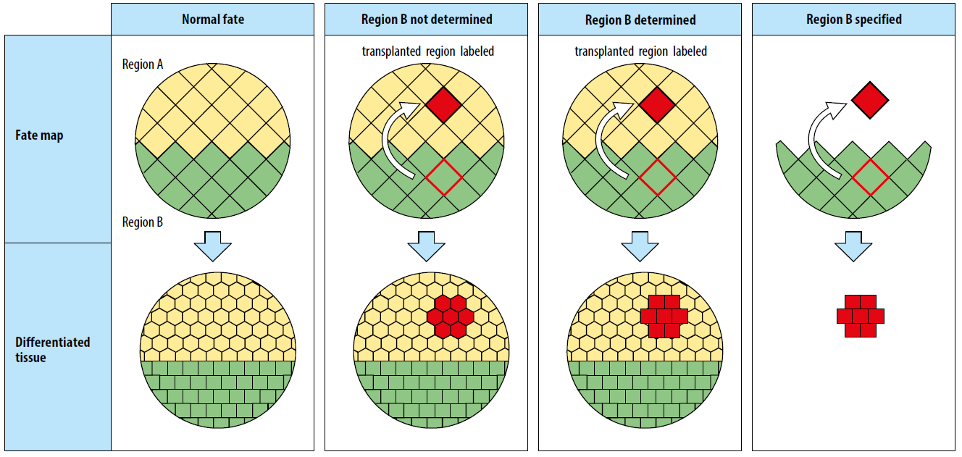
The distinction between cell fate, determination, and specification

